Slide 1
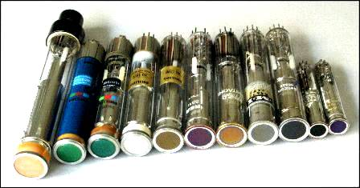
LECTURE FIVE: television CAMERA AND PICTURE TUBES
ET 8105 – Television Systems

Slide 2
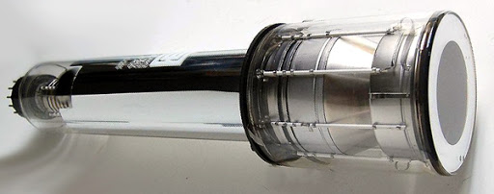
TELEVISION CAMERA TUBES

Slide 3
Introduction
A camera tube is a transducer which converts variations of light intensity into variations of electric current or voltage (video signal).
It is the eye of a television system.
The essential requirements of a camera tube are as follows:
Photosensitive target plate capable of converting an optical image into an electric charge image
Storage of the charge at the points in the target till the time it is not neutralised. The charge should not get dissipated during this time. Hence the target plate should not be a conductor.
Neutralisation of the charge at every point of the target plate in quick succession by the scanning beam, causing current to flow through a load resistor

Slide 4
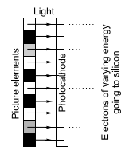
Camera tubes can achieve the above requirements by using any of the following two methods: Photoemission and Photoconduction.
These are described below.
Photoemission
Light incident on a cathode makes electrons come out of it.
The energy of the electrons emitted from any point on the cathode is proportional to the intensity of the light falling on that point.
In this method, electrons move out of the cathode in the form of straight beams and fall on a silicon target.
They form a charge image on the target plate made of glass by causing secondary emission.
Photoemission

Slide 5
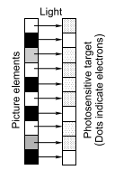
Photoconduction
The incident light creates free electrons inside a semiconductor material.
Number of free electrons created at any point is proportional to the intensity of light at that point.
Image orthicon camera is based on the principle of photoemission.
Vidicon camera tube and its modified versions, plumbicon, saticon, etc. are based on the principle of photoconduction.
Photoconduction

Slide 6
General Characteristics of a Camera Tube
Sensitivity - it is represented in micro-amperes per lumen.
It is about 1000 A for image orthicon, 125 μA for vidicon and 400 μA for plumbicon.
It is measured with a standard source of light, a tungsten lamp at 2870 K.
Self-noise and Signal to Noise Ratio - An electronic device produces noise due to randomness in the number and velocity of electrons.
This randomness, called self-noise, is superimposed over the steady current due to device function and it should be as low as possible.
It is measured in terms of signal to noise ratio which is of the orderof 40 dB for image orthicon and 5-10 dB higher for photoemission typetubes.

Slide 7
Resolution – It depends upon the size of the spot formed by the scanning beam on the target plate.
The diameter of the spot is called aperture which puts a limit to the resolution.
Resolution is usually expressed in terms of percentage of pixels visible distinctly for 400 active scanning lines.
Spectral Response - It denotes the output of a camera tube for the range of wavelengths of light.
Ideally, the spectral response of a camera tube must be the same as the response of the eye.
Although no camera tube can give an ideal result, a good camera tube gives the spectral response quite close to that of the eye in the visible spectrum.

Slide 8
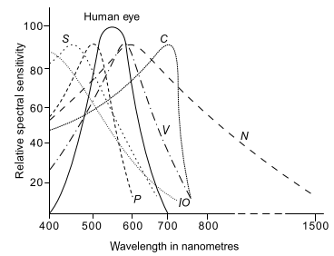
KEY
IO - image orthicon,
V - vidicon,
P - plumbicon,
S - saticon,
C - chalnicon and
N - newvicon.
Spectral response of various camera tubes

Slide 9
Contrast – The ratio of the output signal for white and the output signal for black is called contrast for a camera tube.
Image lag - When the light intensity is too high, all the electrons released by the beam are not able to leave the target, and a fraction of these free electrons is left behind, resulting in slow fading of the image.
It is measured by measuring residual signal current after 60 ms.
When a person in the scene comes in front of a table, the table may be seen through the body of the person as if the person’s body were transparent.
In less severe cases, a bright moving object may show a tail or a smear.
Image lag is quite high in vidicon and negligibly small in other tubes.

Slide 10
Gamma Correction – Gamma represents relationship between the light input and the signal output at the camera tube.
When this relationship is linear, gamma is said to be unity.
Non-linear relationship results in gamma being less.
The importance of gamma arises from the fact that the relationship between signal input and brightness output in the picture tube at the receiver is not linear.
This non linear relationship has less effect in monochrome systems, but a very serious effect in colour systems.
To solve this problem, gamma correction is done so as to modify the characteristic of the camera tube.
Halo Effect - When a ring of brightness or darkness surrounding a picture element is formed, it is called halo.
Image orthicon and plumbicon suffer from halo effect, whereas vidicon does not form haloes

Slide 11
Ghost Effect – It is an image of the same polarity displaced from the high light.
Ghost image becomes most obvious when a sharp contrast exists between dark background and very bright light.
It occurs in image orthicon tube.
Dark Current - Even when no light falls on the target plate, there is some current in the output.
It is called dark current, and is due to the availability of some free electrons at room temperature.
Its value is in nanoamperes.

Slide 12
Vidicon Camera Tube
Vidicon camera tube uses the principle of photoconduction.
The photosensitivetarget is antimony trisulphide (a semiconductor).
When light falls on it, the number of free electrons created at any point is directly proportional to the intensity of light falling on that point.
Brighter the light, greater is the number of free electrons.
These electrons are removed from the material by a positive voltage and hence it becomes positively charged.

Slide 13
The value of charge at any point on the target is proportional to the intensity of light at the corresponding point in the original scene.
Thus a charge image of the picture is formed on the surface of the target.
An electron beam produced by an electron gun of a cathode ray tube scans the charge image horizontally as well as vertically and neutralises the charge fully.
The discharge current flows in a load resistor (not shown in the figure) through the conducting ring and video signal voltage is produced corresponding to the variation of light intensity in the orignal picture.

Slide 14
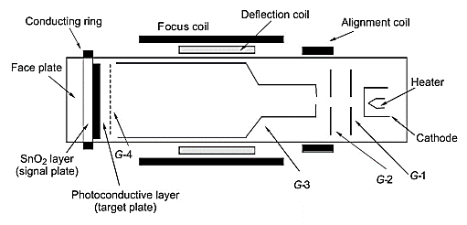
Construction of Vidicon Camera Tube

Slide 15
Neutralising the deficiency of electrons results in an electric current through the load (about 50 kilo ohm)
The electric circuit will be complete through the electron beam and cathode as shown in the next figure.
Current at any spot of scanning will be proportional to the electrons deposited by the beam, which, in turn, will be proportional to the intensity of brightness.
Thus output across the load resistor would be the video signal.
Direction of current shown in the figure is the conventional directionfrom + ve to – ve.
Electrons will move from cathode to the target.

Slide 16
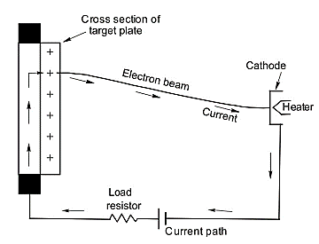
Electric circuit in vidicon

Slide 17
Advantages of Vidicon
Light and hence portable.
Signal to noise ratio better than image orthicon.
No ghost image, no halo.
Resolution is better than image orthicon.
Spectral response is close to that of the eyes.
Sensitivity can be adjusted by changing the target voltage as per illumination of the scene.
No gamma correction is needed.

Slide 18
Disadvantages of Vidicon
Sensitivity, although quite good, is less than that of the image orthicon.
Image lag is severe. In extreme cases, even burn-in of the image may occur.
Dark current (20 nA) is high as compared to other camera tubes
Vidicon camera tube is widely used for outdoor recording, domestic recording and industrial recording.

Slide 19
Plumbicon Camera Tube
Plumbicon camera tube was developed by Philips in 1963 to eliminate image lag effect of vidicon.
It has a photoconductive target plate of lead monooxide (PbO) sandwiched between a n-type and a p-type layer.
The tube has been named plumbicon because lead (plumbum or Pb) has been used in the target material.
It has a sensitivity of 400 μA per lumen which is more than that of vidicon (125 μ A per lumen).
Its signal to noise ratio is also higher than that of vidicon.
It faces halo effect and its size is bigger than vidicon.
Used in studio and outdoor, especially suited to colour TV.

Slide 20
Other Types of Camera Tubes
There are several other types of camera tubes, but we cannot study each one in detail. The goal was to understand the basic principle of operation of TV cameras.
The other types of TV camera include
Image orthicon camera tube
Saticon – Suitable for broadcast
Newvicon
Chalnicon
Silicon-Vidicon Camera Tube (or Silicon Diode Array)
Solid State Camera Based on Charge Coupled Device.
Night Vision Camera Tubes

Slide 21
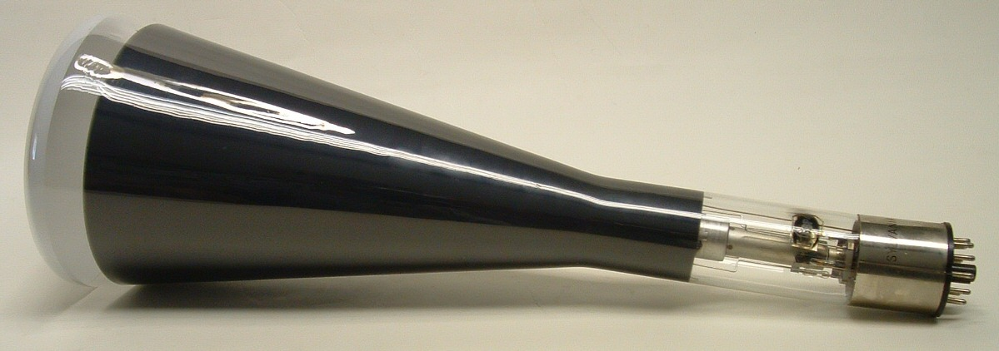
TELEVISION PICTURE TUBES

Slide 22
Introduction
Picture tube is a transducer to convert electrical video signals varying with time into variations of light in space (through width and height of the screen) to reproduce the original picture.
It uses the phenomenon of fluorescence and scanning
Broadly speaking, there are two types of picture tubes
Monochrome picture tube to produce black and white picture.
Colour picture tube to reproduce original colours in the picture.

Slide 23
Monochrome Picture Tube
A monochrome picture tube consists of an evacuated glass envelope, housing an electron gun to produce a sharply focused electron beam and a fluorescent screen to produce light when the electron beam strikes the phosphor elements on the screen.
Also, there are devices to deflect the electron beam horizontally and vertically to enable it to scan the screen through width and height to reproduce the original picture.
Construction of the monochrome picture tube is shown in the next slide
Functions of various elements are also discussed.

Slide 24
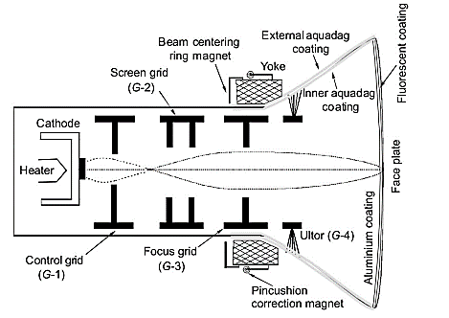
Monochrome picture tube

Slide 25
Cathode – heated and generates an electron beam
Control Grid (G-1) – Controls the brightness on the screen.
Screen Grid (G-2) – Also called accelerating anode
Focus Grid (G-3) – Prevent spreading of the electrons so as to produce a sharp spot on the screen.
Final Anode or Ultor (G-4) – Gives the electrons the required velocity to cause fluorescence in the phosphor material.
Fluorescent Screen – A rectangular plate made of an optically flat glass of high quality coated with phosphor material on the inside. The phosphor particles glow when high velocity electrons strike them.
Deflecting Coils – Deflect the electron beam horizontally and vertically. The mounting block containing the deflection coils is called deflection yoke or simply yoke.

Slide 26
Colour Picture Tubes
In colour picture tubes, voltages pertaining to three primary colours give rise to three electron beams.
These three beams activate three phosphor elements (one each), closely placed in a group, either in the form of dots or in the form of stripes.
Thus there are lights of three primary colours coming out of these three phosphor elements about a point.
The eye integrates the three colours and perceives the single resultant colour.
Based on this principle, we have Delta gun picture tube and Precision-in-line picture tube.

Slide 27
Delta Gun Picture Tube
Consists of three guns, equally spaced at 120˚ with respect to each other.
They are mounted on the corners of an equilateral triangle, forming the capital Greek letter delta (Δ).
The guns are tilted inwards to the tube axis.
Arrangement of the guns are shown in the next slides.

Slide 28
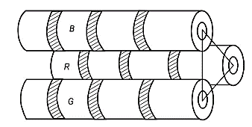
Guns located on the corners of a delta in delta gun picture tube

Slide 29
On the screen, there are about one million dots of phosphor in groups of three, corresponding to red, green and blue light.
These are deposited on the back of the face plate.
Each group is called a triad (shown by three dark dots in the next slide).
Thus there are one-third million triads.
Each dot is of 0.42 mm diameter with a spacing of 0.72 mm between the respective dots of the adjacent triads.
Phosphors used consist of zinc sulphide for red, zinc silicate for green and yattrium for blue.
The space between the phosphor dots is also filled with black pigment which improves contrast and acts as a guard band for correcting errors of beam landing.

Slide 30
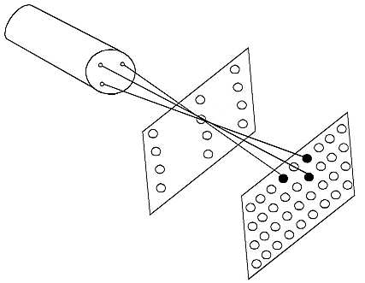
Shadow mask for delta gun picture tube

Slide 31
Principle of Working
Electron beams from the three guns strike three phosphor dots of a triad.
The dots of red, green and blue phosphors in a triad glow simultaneously, the intensity of glow being proportional to the intensity of video signal of the respective colour.
The eye adds the three colours emitted by the phosphor dots at a time and perceives the resultant colour of the concerned pixel as in the original picture.
Triads glow one after the other in quick succession due to deflection of the beams and hence the whole picture reproduced in its original colours.

Slide 32
Shadow Mask
To ensure that the beams land on the correct phosphors, a shadow mask is used.
It is a thin perforated metal sheet located about 9 mm behind the screen.
It is supported by a heavy internal frame for rigidity.
It has one conical hole for each triad.
The hole is conical to prevent emission of secondary electrons from the mask.
Three beams converge on a hole of the mask, and from there they diverge to strike the respective dots of a triad.

Slide 33
Drawback of Delta Gun Picture Tube
Convergence of the three beams on the respective dots difficult. It required four static convergent magnets and one dynamic convergence assembly, resulting in 12 present controls.
As the beams are not in the same line, focus is not sharp all over the screen
Electronic transparency of the shadow mask structure is very low, only 20%. Thus 80% of the beams are stopped from striking the phosphor dots, resulting in poor efficiency.

Slide 34
Precision-in-Line Picture Tube (PIL)
Has three guns which are aligned precisely in a horizontal line in the same plane.
The green gun is in the centre, and the blue and the red guns are on the right and the left, slightly tilted inwards.
Each gun in the picture tube has its own cathode, control grid, screen grid and focus grid.
Colour phosphors are deposited on the screen in the form of fine vertical stripes in groups of three stripes of red, green and blue phosphors.

Slide 35
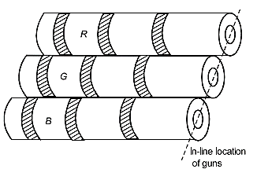
Guns in in-line-configuration in PIL picture tube

Slide 36
The shadow mask placed 9 mm behind the screen has vertical slots corresponding to colour phosphor stripes.
One vertical slot is for one group of three stripes.
The slots in the mask are so located that each beam strikes its own phosphor stripe only, as shown in the next slide.
The three phosphor stripes in a group produce three colours, red, green and blue simultaneously when beams from the three guns strike the stripes.
The eye adds the three colours and perceives the original colour of the pixel.

Slide 37
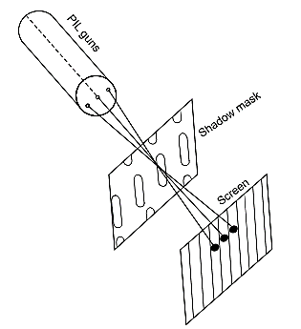
PIL picture tube’s mask

Slide 38
Advantages of PIL Picture Tube
The PIL tube has the following advantages over delta gun picture tube and is therefore widely used in TV receivers.
Due to vertical slots, electron transparency is about 50%, which is much more than 20% for the delta gun picture tube. Hence efficiency is better.
Vertical convergence is not needed and hence convergence adjustments are less than required in the delta gun picture tube. Even horizontal convergence is needed only at the stage of manufacturing. Thus no convergence is required during servicing
Focus is sharp all through the screen as the guns are in the same plane.

Slide 39
Trinitron Picture Tube
The trinitron picture tube employed three cathodes, but only one control grid, one screen grid and one focus grid for all the three beams, as shown in the next figure.
All the three cathodes are in line.
The control grid is a single cup type electrode with three holes for three beams.
The screen and the focus grid are common for three beams.
The shadow mask has long slots, one slot per vertical line, increasing transparency to about 80%

Slide 40
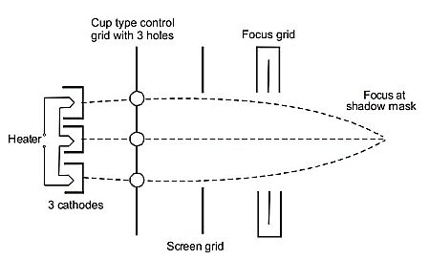
Electrodes in Trinitron Picture tube

Slide 41
Fluorescent screen is of the same type as in PIL picture tube, consisting of phosphor stripes in groups of three, one for each primary colour (red, green and blue)
For focusing, trinitron uses low voltage focussing system, requiring 400 V (variable) at the focus grid and using two small ultor cylinders one to the left and one to the right of the focus grid.

Slide 42
Advantages of Trinitron Picture Tube
Improved vertical resolution
Greater transparency for the electron beam, being about 80% against 20% for the delta gun and 50% for the PIL picture tube. Consequently efficiency is high
Controls are only 6 against 12 in delta gun and PIL picture tubes
Sharper focus and brighter picture
No problem of convergence adjustment during servicing

Slide 43
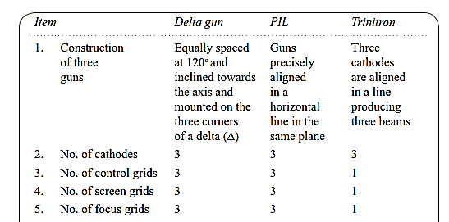
Comparison of Colour Picture Tubes

Slide 44
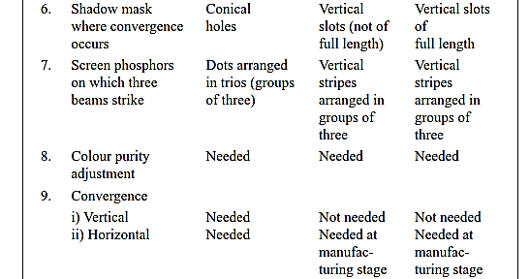

Slide 45


Slide 46
Adjustments in Colour Picture Tube
The three beams in a colour picture tube must land on the respective phosphor dots or stripes correctly.
Any mis-registration will result in production of wrong colour.
To ensure correct registration, adjustments of colour purity(for the raster) and of convergence of the beams (for individual pixels) is to be made accurately.
Besides the deflection yoke, a colour picture tube has a convergence yoke, and blue lateral shift and colour purity rings as shown in the next sketch.

Slide 47
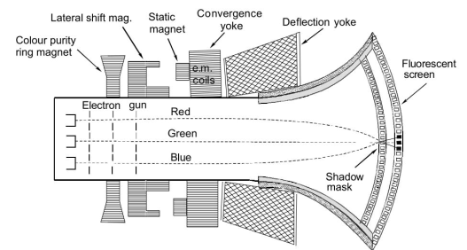
Layout of different external yokes and components

Slide 48
Colour Purity Adjustment
The shadow mask and the phosphor dots or stripes are so aligned that electrons from the red gun strike the red phosphors only, electrons from the green gun strike the green phosphors only and those from the blue gun, blue phosphors only.
The raster visible on the screen should be white when all the three guns are on and the beam currents are balanced for neutral white.
If not, there is an error in the landing of the beams on the phosphor elements and the tube needs adjustment.
This is called colour purity adjustment.
The colour purity ring magnet is mounted behind the yoke towards the tube socket.

Slide 49
Adjustment of Convergence
When colour purity has been adjusted, it may happen that red signals do activate red phosphors all right, but they do not activate red phosphors of the concerned triad.
Thus raster would be all right, but the individual pixel may not show its correct colour.
Hence it is necessary that each beam is adjusted individually so that the three beams fall on the three dots of the same triad.
Adjustments are made for white.
Incorrect convergence of a single primary colour results in colour fringes in the picture.

Slide 50
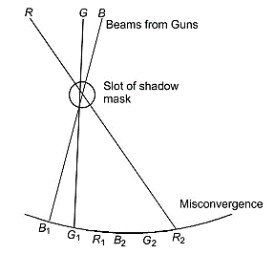
Consider this figure, For correct convergence blue, green and red beams should fall on B₁, G₁ and R₁ phosphors of a pixel, but instead of that if they fall on B₁, G₁ andR₂ resulting into mis-convergence.
In this case the right edge of a white dot will show a red fringe and the left edge of the dot will be missing in red and hence will show cyan.
There are two types of convergence adjustments: (1) Static convergence and (2) Dynamic convergence.
Misconvergence at the centre

Slide 51
Static convergence
There are internal magnetic pole pieces built into the guns.
An external magnetic assembly, called convergence yoke couples flux into the internal pieces through the glass neck.
The convergence yoke is mounted just behind the deflection yoke towards the socket side.
The convergence yoke has three permanent magnets, one each for green red and blue.
The blue one is either at the top or bottom of the delta type arrangement.
Its cross-sectional view is shown in the next slide.

Slide 52
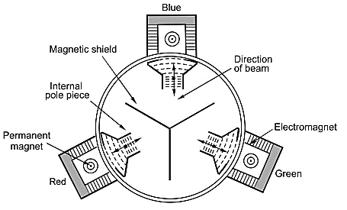
Cross-sectional view of the convergence yoke

Slide 53
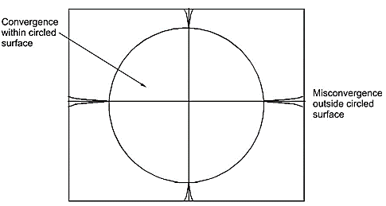
Dynamic convergence
After correct convergence at the centre, it is correctly maintained on the spherical surface formed by the radial distance between the screen and the guns.
However this sphere is more curved than the screen and hence beams converge a little short of the screen.
Then they diverge and hit the screen mis-converged

Slide 54
For correct convergence at the edges, the beams should converge at a larger distance so that convergence even at the edges is correct.
This is done with the help of an ac current of parabolic shape modified by a sawtooth form.
Parabolic form of current is clamped to zero at middle so that it does not disturb the static adjustment at the centre.
The waveform at sides is symmetrical and hence stretches the convergence to the sides.
To get the desired waveform, two coils are used on each pole piece, one for vertical deflection and the other for horizontal deflection

Slide 55
Grey Scale Tracking
If equal quantities of red, green and blue lights are incident on the eye, we see white light or grey shades of white depending on the ambient light.
However, due to different efficiencies of colour phosphors, and lack of similarity in the three guns of a colour picture tube, equal signals at the input may not give white light for all settings of brightness control.
The ability of the picture tube to maintain output at white, when the input varies from very bright parts to dark parts of a picture, or when the brightness control is varied from high to low is called grey scale tracking.

Slide 56
Pincushion Effect
Had the screen been circular, magnetic deflection would have been uniform , as all points on the screen would have been equidistant from centre of deflection.
However, the screen is not circular but is rectangular and hence distance of the corners is more as compared to the central portion making the raster to be stretched at the corners.
It takes the shape shown in the next slide.
This is called pincushion effect as the raster resembles the shape of a pincushion.
This will cause distortion in the picture.

Slide 57
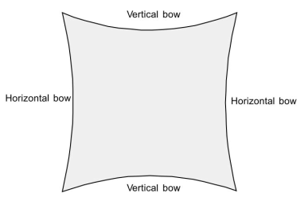
pincushion effect

Slide 58
In monochrome picture tubes, the pincushion effect is rectified by using small permanent magnets on the deflection yoke.
These pull the curved sides of the raster by providing extra field in the desired direction.
These magnets can be adjusted to correct the deflection so that the raster becomes perfectly rectangular.
Pincushion magnets cannot be used with colour picture tubes because any adjustment of magnets will upset colour purity adjustment.
Hence in colour picture tubes, instead of using permanent magnets, current through the deflection coils is so changed as to straighten the raster at horizontal (left and right) and vertical (top and bottom) sides.

Slide 59
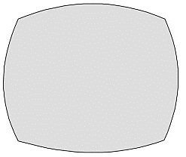
Barrel Effect
This is opposite to the pincushion effect where the scanning lines bow outwards.
This is again due to distorted magnetic field making vertical deflection current to be bowl shaped and the horizontal deflection current to be more at the centre and less at the corners.
It can be corrected by superimposing an opposing type of magnetizing current in the respective deflection coils.
Barrel effect

Slide 60
Solid State Picture Transducers
The conventional picture tubes are thermionic tubes, using heated cathodes to emit electrons in vacuum and control the same by means of electrostatic fields through various grids
These tubes have all the disadvantages of thermionic devices like bulky size, provision of a heater, provision of vacuum, high voltages, etc.
Scientists dreamed for a long time to discover suitable solid state transducers and develop a real flat panel.
Studies of the devices like plasma display panels and liquid crystal display (LCD) has been pursued towards the end.

Slide 61
Plasma Display Panels
The panel consists of tiny plasma cells which hold a mixture of low pressure inert gases like xenon, neon and helium (also known as noble gases) and a small amount of mercury.
These tiny cells are also called chambers.
There are hundreds of thousands of such cells in the space between two panels of glass.
The structure of a typical plasma display panel is shown in the next slide

Slide 62
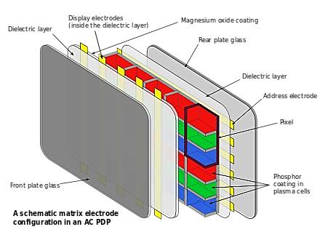
Sketch of plasma display panel

Slide 63
Tiny plasma cells are contained in the space between two glass plates.
The cells are coated with phosphor elements on the back side.
Also, there are long electrodes on the back side and on the front side of the cells sandwiched between the glass plates.
Electrodes behind the cells are called address electrodes, and those in the front are called display electrodes.
They are transparent, surrounded by insulating dielectric material, and covered by a protective layer of magnesium oxide.
When varying electric signal is applied to the electrode, a varying potential difference appears across the cells.
This ionizes the gases, converting them into plasma

Slide 64
While moving through the plasma, the negatively charged electrons strike the molecule of mercury vapour.
These molecules get excited to a higher energy level momentarily, and when they return to their normal state, the excess energy is released in the form of ultraviolet (UV) rays.
Thus, plasma cells act like tiny fluorescent lamps
The ultraviolet rays strike the phosphor elements, available on the back side of each cell, and make them glow.
Each pixel in plasma display is made up of three cells, pertaining to three primary colours.
For every cell there is a phosphor element, and when a pixel is activated, these cells produce UV light which strikes the phosphor dots

Slide 65
For every cell there is a phosphor element, and when a pixel is activated, these cells produce UV light which strikes the phosphor dots and makes them emit red, green and blue light.
Thus the video signal is converted into original colour picture.
Size – Plasma displays have sizes larger than 80cm. Sizes up to 4 metres have been achieved, and possible larger size than this have been developed.

Slide 66
Advantages of Plasma Display Panels
They are quite slim with thickness about 5 cm.
They can be easily hung on a wall
They have large size thus giving life-size effect as in cinematography
Superior contrast
Brighter picture
Very fast response, hence no motion blur in fast moving objects, like cricket ball

Slide 67
Disadvantages of Plasma Display Panels
Not available in small sizes, hence cannot be used in laptop computers, calculators, etc.
Although slimmer than traditional LCD type, it is heavier due to the use of glass plates. LCD uses plastic
Consumes more power than LCD
Cannot work well on high altitudes due to pressure problems
Prone to radio frequency interference
Plasma contributes to global warming as nitrogen trifluoride (a very potent green house gas) is used during production.

Slide 68
Liquid Crystal Displays
Liquid crystals are organic compounds whose physical properties are the same as those of a crystal, but whose behaviour resembles that of a liquid.
Hence they are known as liquid crystals.
A molecule of a liquid crystal has an elongated rod like shape and its structure is somewhat rigid.
Electric conductivity, refractive index and polarisation of light coming out of it depends on the orientation of its crystals.
This property of liquid crystal is used to make the light, passing through it, change its polarisation.

Slide 69
The liquid crystals adjust themselves parallel or perpendicular to the electric field.
The electric field applied to an LCD cell twists the molecules, the twist being proportional to the signal voltage.
The electric field is applied at right angles to the axes of liquid crystals.
The LCD elements has a thin liquid crystal sandwiched between two transparent plates.
When the voltage applied to the plates varies, the polarization of light passing through the liquid crystals changes.
It can change between 0 and 90 degree.
The action of an LCD is shown in the next figure.

Slide 70
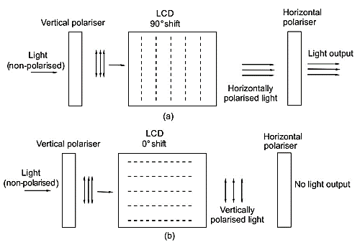
(a) Orientation of liquid crystal molecules to allow light in the output
(b) Orientation of liquid crystal molecules to block light

Slide 71
The polarization of the incident light is random.
The vertical polarizer selects only vertically polarized light.
In figure (a), the LCD crystal causes a shift of 90˚ in the polarization and hence it becomes horizontally polarized light.
The next polarizer is the horizontal polarizer which allows this light to pass and so light comes out of the LCD element.
In figure (b), the LCD causes no shift in polarization.
So the light coming out of the liquid elements remains vertically polarized, which is stopped by the horizontal polarizer.
Thus no light will come out of the LCD element.
Consequently, the transparency of the LCD pixel element will depend on the degree of shift in polarization.

Slide 72
It will have different intensity within two limits of full light to zero light.
Relationship between signal voltage and transparency of the cell is linear.
In a practical system, 100,000 – 400,000 pixel of LCDs are arranged in a rectangular matrix.
Each pixel is controlled individually by its built-in thin film transistor (TFT).
It can be opened or closed or driven to any point between the two extremes to produce the original pattern of light intensity on the screen.
It gives a monochrome picture.

Slide 73
To produce colour display, each LCD cell is given a colour filter.
There would be three cells per pixel which will have green, red and blue filters.
Thus the light coming out will have three primary colours for each pixel, which will be added by the eyes to get the original colour.
Pocket TV receivers, electronic toys and laptop computer monitors are widely using LCD display panels because of their obvious advantages of low power, small weight, compactness and high reliability.
In LCD there are no phosphor elements; the crystal itself produces variations of light and colour, proportional to those present in the original picture.

Slide 74
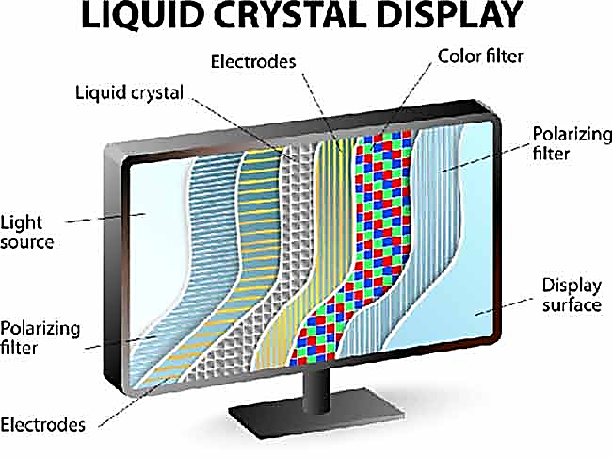
Cross section of a typical LCD panel

Slide 75
Due to the requirement of a source of light, called back light, LCDs are now categorized into two types:
Traditional LCD
LED LCD
In traditional LCD, the back light is provided by a cold cathode fluorescent lamp (CCFL)
The modern LCD panels use light emitting diodes (LEDs) for the back light.
Manufactures prefer to call such a panel an LED TV.
Basically, an LCD is the one which is used as a transducer; and LEDs are used to provide a source of back light only, in place of CCFL.

Slide 76
The back light can be produced by using LEDs in blocks directly behind the screen called back lit screen.
Alternatively, they can be placed around the edge of the screen called edge lit screen.
In the edge lit screen, the light spreads out across the back from the sides

Slide 77
Advantages of LCD Panel
Power consumption is very low, even compared to plasma panels.
LCD panels do not use glass plates, but use plastic plates, so they are very much lighter than plasma panels.
LCDs using LEDs as source of back light are thinner than plasma panels. The edge lit LCD panels are as thin as 1 cm
Unlike plasma panels, there is no problem at high altitudes

Slide 78
LCD vs Plasma
There is great competition between LCD and plasma screens.
But because of lower power consumption and lack of greenhouse gases, LCD screens have an edge over plasma screens.
Moreover, LCD screens using LEDs have become even much slimmer.

Slide 79
Projection Television
Traditional TV sets, using cathode ray tubes for display, were good enough for standard definition TV systems.
However, their size was limited to less than 100 cm (diagonal)
Although the CRT provided great pictures, they could not satisfy those who wanted to enjoy life-size pictures (as in cinema halls).
Plasma panels and LCDs were developed, which were capable of producing life-size pictures.
Both these devices are luxury items, and are too costly at present.
Search for such devices that would give larger pictures at affordable costs continued, and the search efforts succeeded, resulting in projection television.

Slide 80
The projection TV is the methodology used to display TV pictures on a cinema like screen with the help of a projector.
The projection TV uses a projector to create small images out of the input video signal and magnify the same with the help of a bright beam of light and a magnifying lens system.
There are two types of projections:
Front projection
Rear projection

Slide 81
Front Projection
In the front projection, the method used is the same as that employed in showing motion pictures in cinema theaters.
The projector is placed separate from the screen at some elevated place, for example, a table.
In cinema halls, it is placed in a separate room , called projector room.
The magnified version of the small image is formed on the front side of the screen.
In this method, even a well painted (white) wall can work as a screen.

Slide 82
Rear Projection
Rear projection is similar to the presentation on the screen of the picture tube in normal TV systems, in which the phosphor elements that glow are on the back side of the face plate.
The viewer sees the back side through the transparency of the glass.
So, it is the rear display. In rear projection TV, the projector is generally kept inside the TV itself (although not mandatory) and the small image formed by the video signal is magnified and projected on a screen kept outside but near the TV set.
Thus, the magnified image will be formed on the rear side of the screen with respect to the viewer, as in the case of normal TV.

Slide 83
Rear projection, although it occupies more floor space (because viewers cannot sit between the projector and the screen), became more acceptable on account of it being cheaper than the front projection type and because of the fact that the normal TV screen could also be viewed in this method.
Moreover, the front type projection requires a dark room and so is not convenient for homely atmosphere.

Slide 84
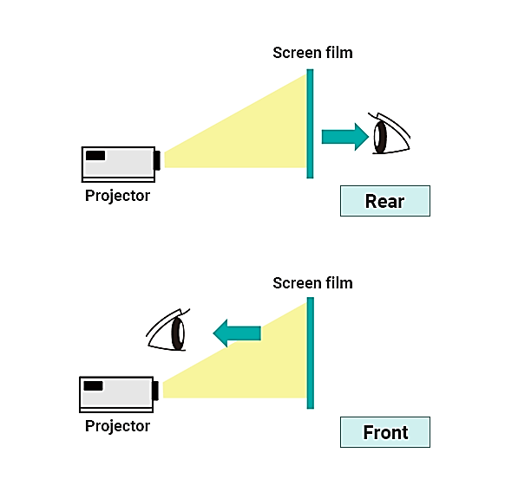
Rear Projection
vs
Front Projection

Slide 85
Techniques Used in Projection TV
Both arrangements (front and rear) use small images with fine details, created by video signals; magnify them by using beams of bright light and a magnifying lens and project on the screen’s front or back by either transmission or reflection.
Transmission Technique – Transmittive-type projectors use small CRTs or small LCDs.
The transmission path is shown in the next figure

Slide 86
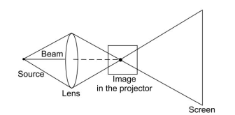
Display of Projection TV by transmission method

Slide 87
The small sized CRTs are used to create small pictures by making phosphor elements glow when the electron beam strikes the phosphors.
Beam from a source of light is focused on the small image by a magnifying lens.
The rays coming out of the image diverge and reach the screen creating a magnified image.
Small low cost LCDs can also be used in place of CRTs.
The video signal makes the liquid crystals act as valves, opening or closing as per polarization produced by the video signal.
Each beam of green, red and blue colours passes through the respective LCD and a lens collects the resultant light and projects the image on the screen.

Slide 88
The Reflective Technique – It uses digital light processing (DLP) device which contains millions of micro mirrors on a small chip.
There is a mirror for each pixel.
The chip is known as digital mirror device (DMD).
When the mirrors point towards the lens, the reflected light reaches the lens, and when they are away from the lens, there is no light coming to the lens.
The mirrors are moved as per the video signal pulses.
The next figure illustrates reflective projection technique.

Slide 89
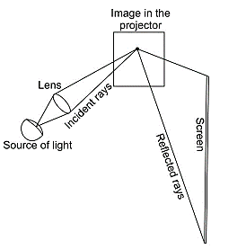
Display of projection TV by reflective method

